Slide 1
UNIT II DIVIDE AND CONQUER
Session – 12

Slide 2
Syllabus
Introduction, Binary Search - Merge sort and its algorithm analysis - Quick sort and its algorithm analysis - Strassen's Matrix multiplication - Finding Maximum and minimum - Algorithm for finding closest pair - Convex Hull Problem

Slide 3
Introduction
Divide / Break
Conquer / Solve
Merge / Combine

Slide 4
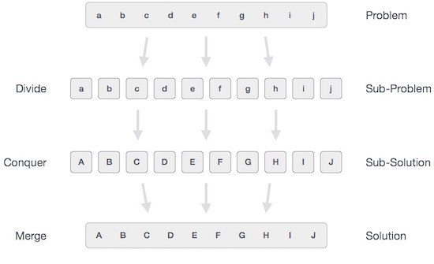

Slide 5
Strassen’s Multiplication – Naive Method
Given two square matrices A and B of size
n x n each, find their multiplication matrix.
Naive Method
void multiply(int A[][N], int B[][N], int C[][N])
{
for (int i = 0; i < N; i++)
{
for (int j = 0; j < N; j++)
{
C[i][j] = 0;
for (int k = 0; k < N; k++)
{
C[i][j] += A[i][k]*B[k][j];
}
}
}
} // Time Complexity of above method is O(N³).

Slide 6
Strassen’s Multiplication – Divide and Conquer
Following is simple Divide and Conquer method to multiply two square matrices.
1) Divide matrices A and B in 4 sub-matrices of size N/2 x N/2 as shown in the below diagram.
2) Calculate following values recursively. ae+bg, af+bh, ce+dg and cf+dh.
In the above method, we do 8 multiplications for matrices of size N/2 x N/2 and 4 additions. Addition of two matrices takes O(N²) time. So the time complexity can be written as T(N) = 8T(N/2) + O(N²)
From Master's Theorem, time complexity of above method is O(N³) which is unfortunately same as the above naive method.

Slide 7
Simple Divide and Conquer also leads to O(N³), can there be a better way?
In the above divide and conquer method, the main component for high time complexity is 8 recursive calls.
The idea of Strassen’s method is to reduce the number of recursive calls to 7. Strassen’s method is similar to above simple divide and conquer method in the sense that this method also divides matrices to submatrices of size N/2 x N/2 as shown in the above diagram, but in Strassen’s method, the four sub-matrices of result are calculated using following formulae.

Slide 8
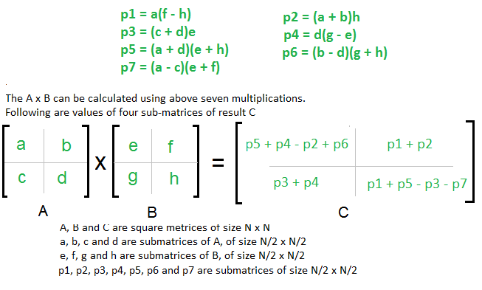

Slide 9
Generally, Strassen’s Method is not preferred for practical applications for following reasons.
The constants used in Strassen’s method are high and for a typical application Naive method works better.
For Sparse matrices, there are better methods especially designed for them.
The sub matrices in recursion take extra space.
Because of the limited precision of computer arithmetic on non integer values, larger errors accumulate in Strassen’s algorithm than in Naive Method

Slide 10
Using Master’s theorem
Time Complexity
T(n) = 7T(n/2) + ϴ(n²)
T(n) = aT(n/b) + f(n) where a >= 1 and b > 1
a = 7 b = 2 f(n) = n²
If f(n) < O(n^{log}_{b}ª), then T (n) = ϴ (n^{log}_{b}ª).
If f(n) = ϴ (n^{log}_{b}ªlog^{k}n) with k≥0, then T (n) = ϴ (n^{log}_{b}ªlog^{k+1}n).
If f(n) > Ω (n^{log}_{b}ª), and f(n) satisfies the regularity condition, then T (n) = ϴ (f(n)).
Calculate n^{log}_{b}ª = n^{log}₂⁷ = n^{2.8074}
Compare with f(n). Since f(n) < n^{log}_{b}ª
i.e. n² = n^{2.8074}
Case 1 is satisfied hence complexity is given as
T(n) = Θ(n^{log}_{b}ª) = Θ (n^{2.8074})

Slide 11
Worksheet No. 12

